Slide 1
Automatically judging the native-likeness of a learner’s English pronunciation
Martijn Wieling

Slide 2
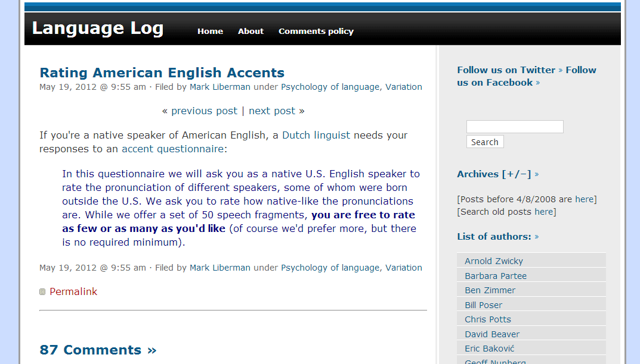
Judging non-native English speech
Adequate automatic transcription-based methods exist , but transcribing speech is expensive
Goal of the MA project:
To develop a method which only uses the acoustic data to evaluate the learner’s speech (i.e. assign a score)
Methods: transformation of the acoustic signal to Mel-Filtered Cepstral Coefficients, ML techniques
Training and evaluation via data from the speech accent archive: 1000 speakers with transcription-based native-likeness ratings, including 300 with human native-likenss judgments

Slide 3
Characterizing Dutch and Flemish language use on Twitter
Martijn Wieling and Gosse Bouma

Slide 4
Regional variation
3% of Dutch tweets contain geo. coordinates
Goal of the MA project is:
To identify characteristic vocabulary differences between Netherlandic Dutch and Flemish Dutch and compare this to known distinctions
Assess geographical distributions of sets of (near-)synomyms

Slide 5
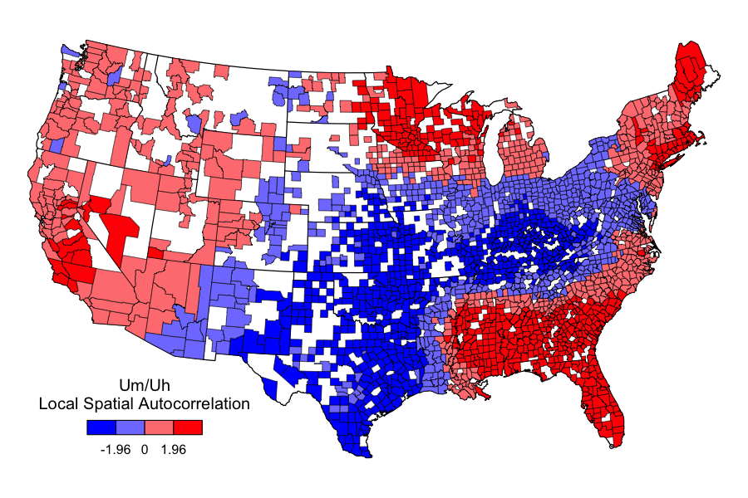
Example (English)

Slide 6
Discovering typical characteristics of English accents
John Nerbonne and Jelke Bloem

Slide 7
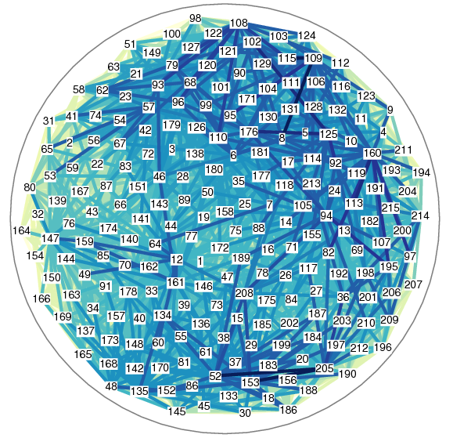
Accent characteristics
When someone has a Dutch accent, how can you tell? What is typical?
Goal of the project:
Compute what characterizes an accent of a specific language (i.e. Dunglish/steenkolenengels)
Or develop a new method for doing so
Method:
Cluster analysis method on Speech Accent Archive data
Dunglish cluster vs English cluster
Notes:
The goal can be to study the accent of a specific language(s) computationally, or to develop a method to do so (for the more technical people)
There are existing methods to compute cluster determinants (in GabMap) but maybe this can be improved upon (i.e. do it per phoneme instead of per word form)
You can also say it has applications in pronunciation training.
Voor als iemand het vraagt: het plaatje is een difference map uit GabMap, en laat de verschillen zien tussen de uitspraak van 1 woord door alle sprekers in beide clusters.

Slide 8
Accents and the language tree
John Nerbonne and Jelke Bloem

Slide 9
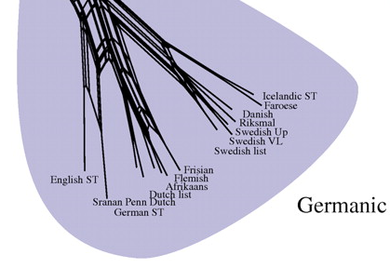
Accents and the language tree
It may seem obvious that languages less related to English cause stronger accents… But is that true? Not all linguistic properties affect pronunciation of language
Goal of the project:
Discover which linguistic properties predict accent distance
Method:
Mine typological databases such as WALS World Atlas of Language Structures
Compare to computational measures of accent distance
Notes:
You can say what a typological database is (contains information about properties such as word order, which have been determined for many languages) and what accent distance means

